Slide 1
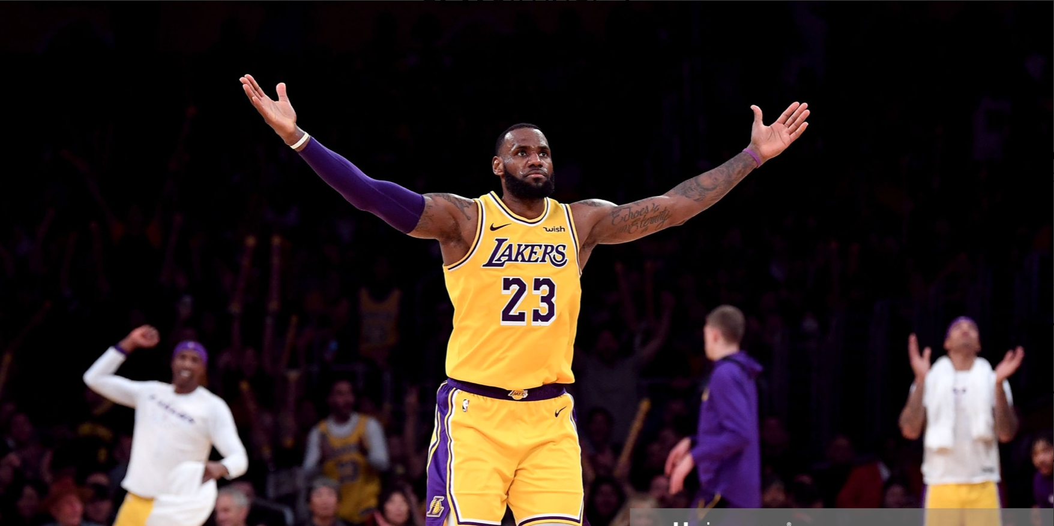
Predicting Team success (Win/Loss) based on Lebron James performance
By: Ali Hussain

Slide 2
Dataset
Features: (Total 24)
FGM, FG%, 3PM, 3P% ,FT, FT%, FTA, Minutes-Played, Age, RB, ORB, STLS, TO, TEAM, AST, BLK, STLS, Plus-Minus (+/-)
Engineered features:
Assist to Turnover Ratio (A/T)
Effective Field Goal % (EFG %)
Game-Score
Target: Team Win or Loss
Dataset Summary:
1132 observations (every game Lebron played from 2003-2018)
Class Imbalance: 753 Wins (66%) 379 Losses (34%)
Notes:
Dataset found on kaggle. Information initially from nba reference.
Game-Score It is intended to give a “total perspective” on a player’s statistical performance in a basketball game, taking into account every statistic listed on a player’s box score.

Slide 3
Exploratory Data Analysis (EDA) Visualizations

Slide 4
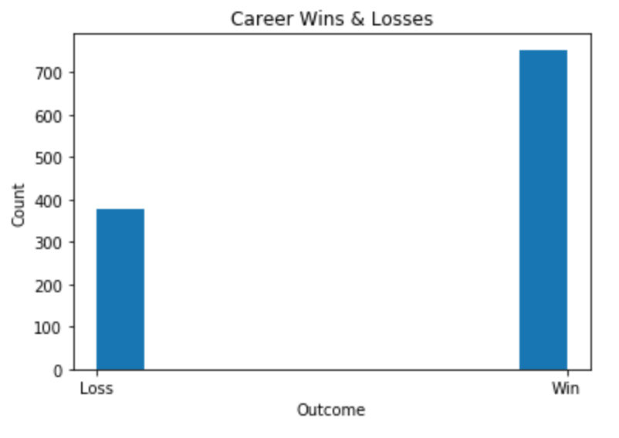
Notes:
Class Imbalance: 753 Wins (66%) 379 Losses (36%)
Does this class imbalance effect results? Yes model predicts wins more but with 93% accuracy

Slide 5
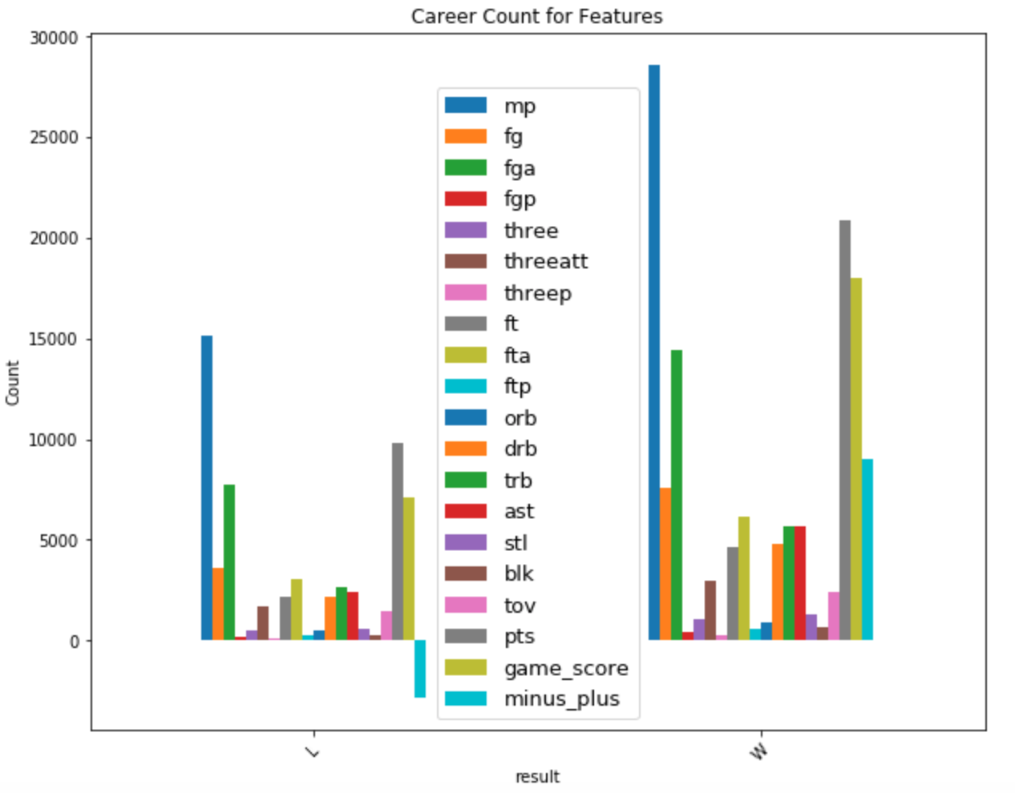
Notes:
Comparing career count for features
Some of the key features that stand out pts, ft, , fga, fta fga plus-minus

Slide 6
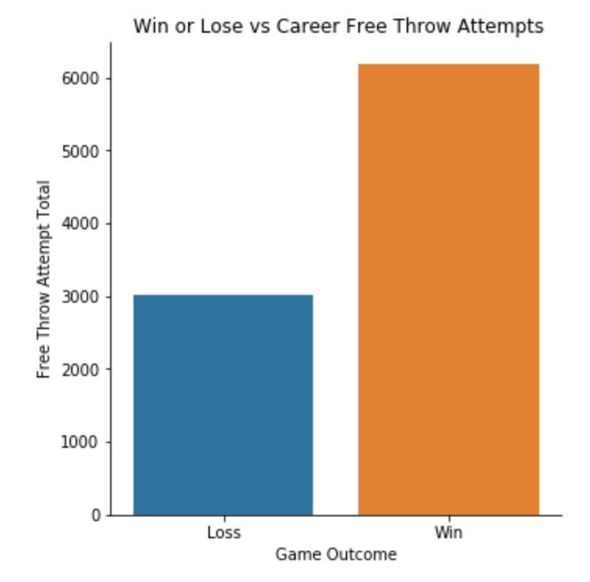
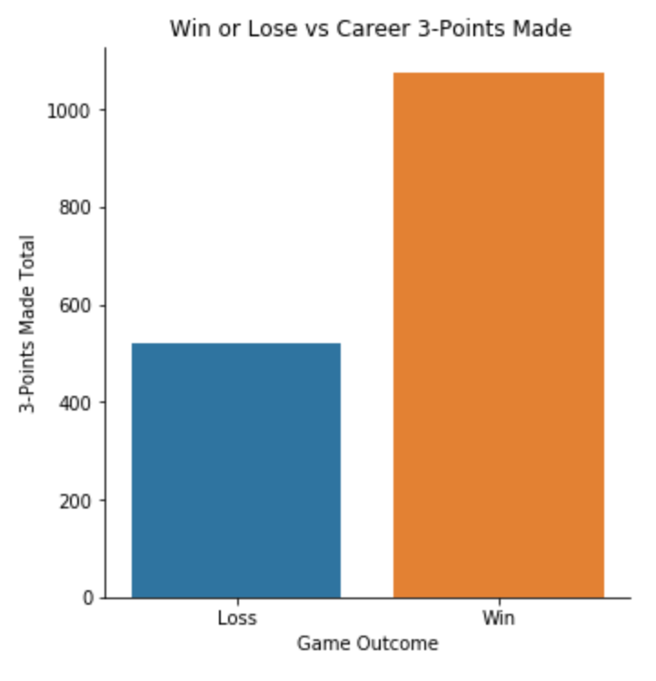

Slide 7
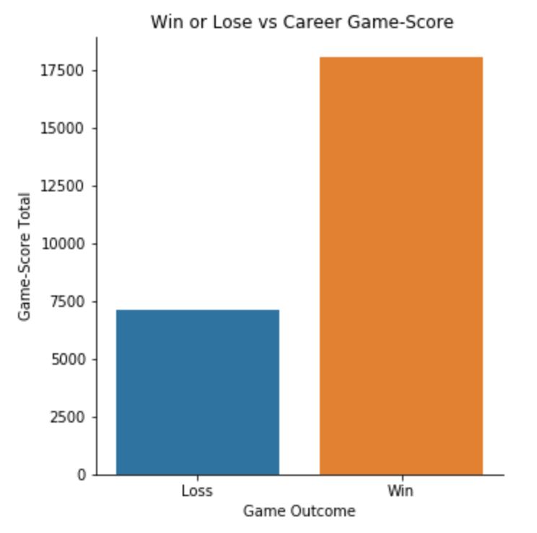
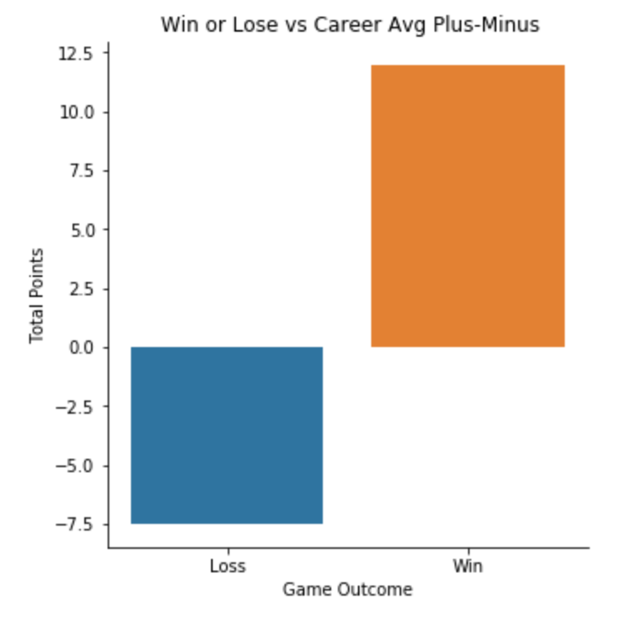
Notes:
Define Game-score - ***
Define plus - minus **** uses a players box score numbers (basic stats) by weighing each stat differently to reflects how the team did while that player is on the court. If a player has a +5 PM, it means his team outscored the opponent by 5 points while he was on the court. If he has a -3, then the opposing team outscored his team by 3 points while he was on the court.

Slide 8
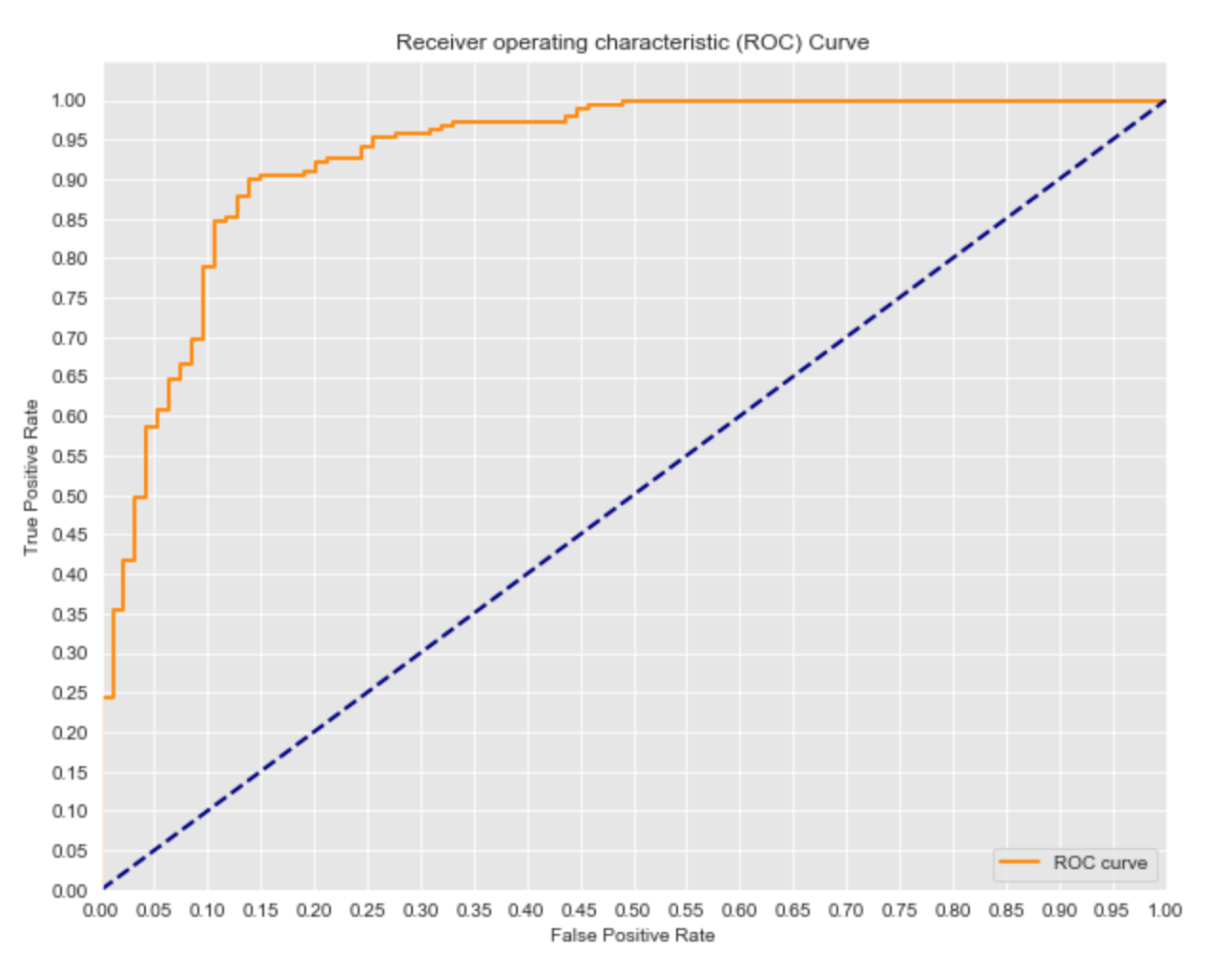
First Model - Logistic Regression
Training Accuracy - 89.4 %
Test Accuracy - 86.9%
AUC - 93.1%
Notes:
Not a bad model. Training and Test are close in range/ training model is a little overfitting
ROC curve indicates ideal true positive rate and false positive rate to achieve best overall accuracy
Comparing sensitivity and specificity for different cutoff points. shows overall accuracy.
AUC is good as well - how good this model is under a different situation

Slide 9
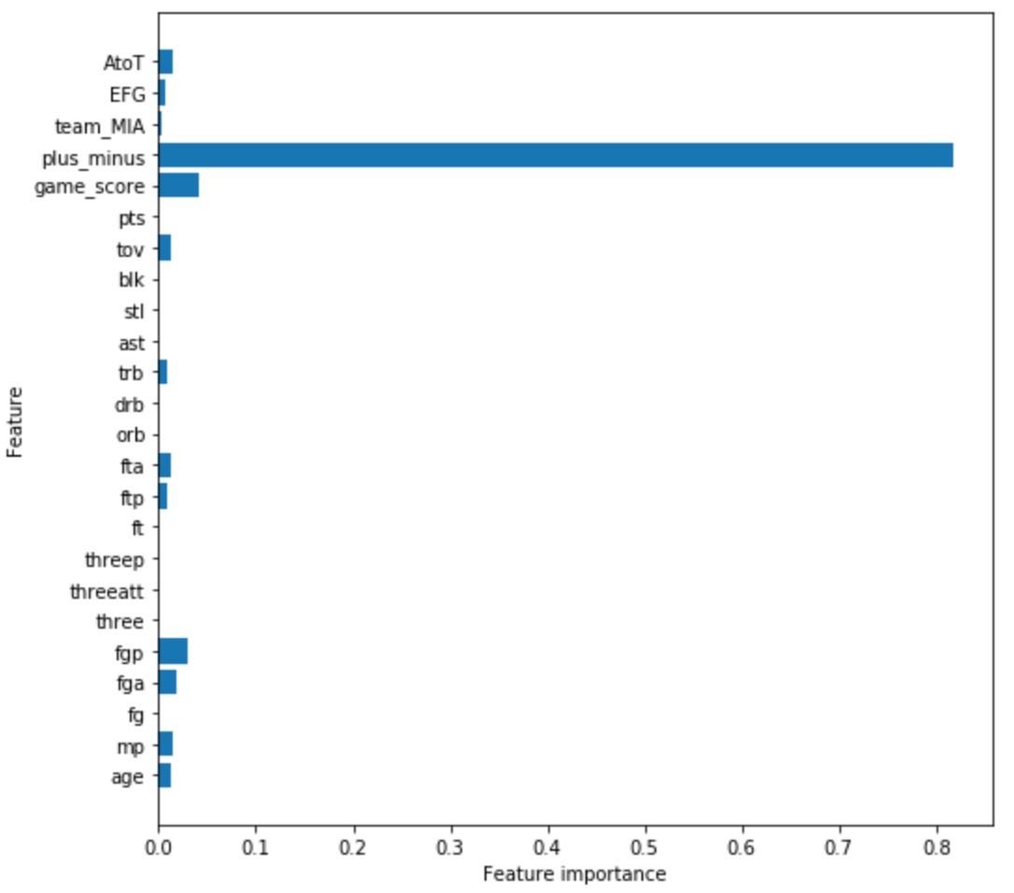
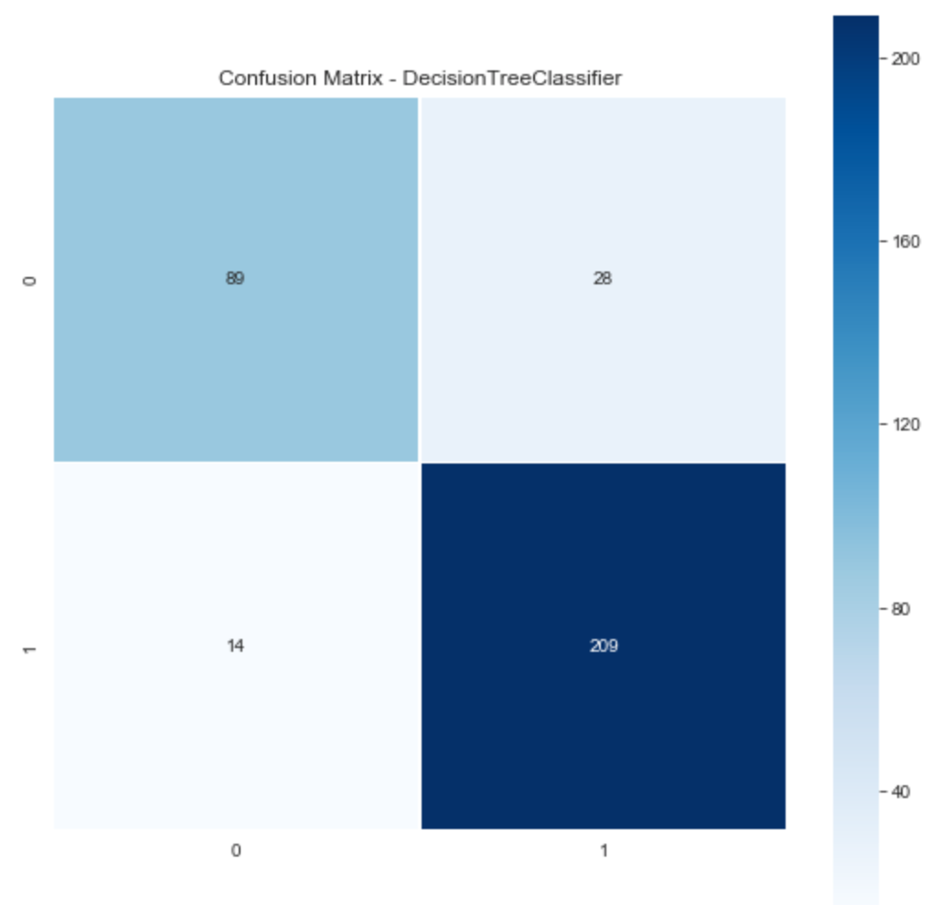
Decision Tree Model -Score and Confusion Matrix
Training Accuracy- 94.19 %
Validation Accuracy- 87.94 %
Notes:
Confusion Matrix - (sky blue)TN 89 /379 (navy blue)TP 209 /379
white(bottom) FN 14 /379 (white top)FP 28 /379
Chose accuracy as the metric to assess models because it indicates the amount of tp tn out of all the test samples my model is indicating.
Accuracy - TP + TN/ TOTAL how many I’m classifying correctly 87.94%
Performance importance shows which feature contributed the most in splitting. Plus minus provided the most information gain

Slide 10
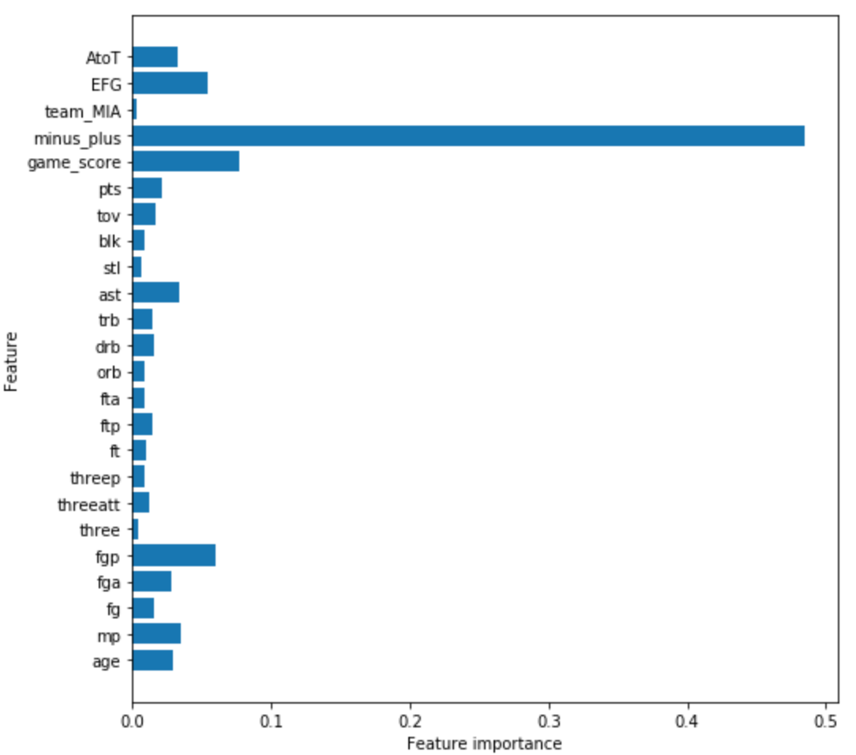
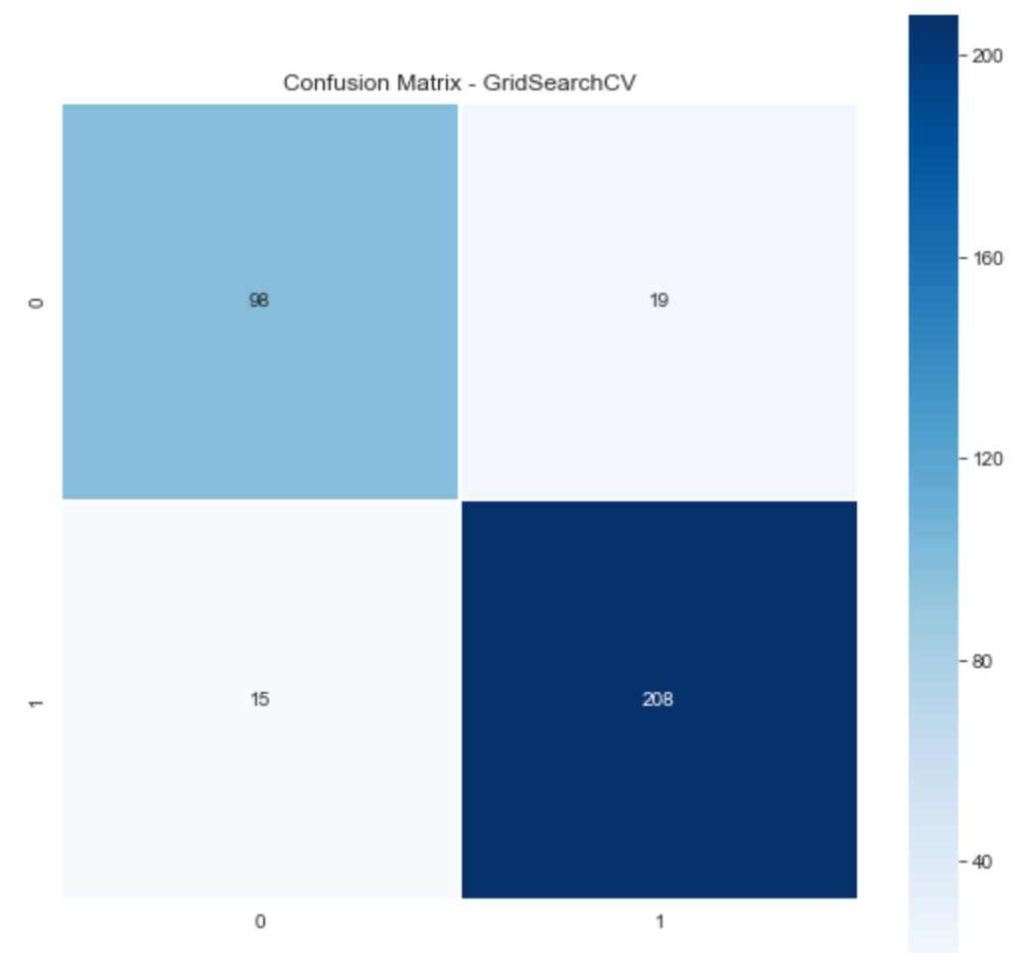
Random Forest Model - Score, Confusion Matrix, and Feature Importance
Training Accuracy - 89.52%
Validation Accuracy - 90 %
Notes:
Confusion Matrix - (sky blue)TN 96 /379 (navy blue)TP 208 /379
white(bottom) FN 15 /379 (white top)FP 19 /379
False positive went down compared to before and true negative went up by 10 each so overall accuracy went up
Accuracy - TP + TN/ TOTAL how many I’m classifying correctly 90% accuracy went up by 1%
Other features are providing more information to classify correctly

Slide 11
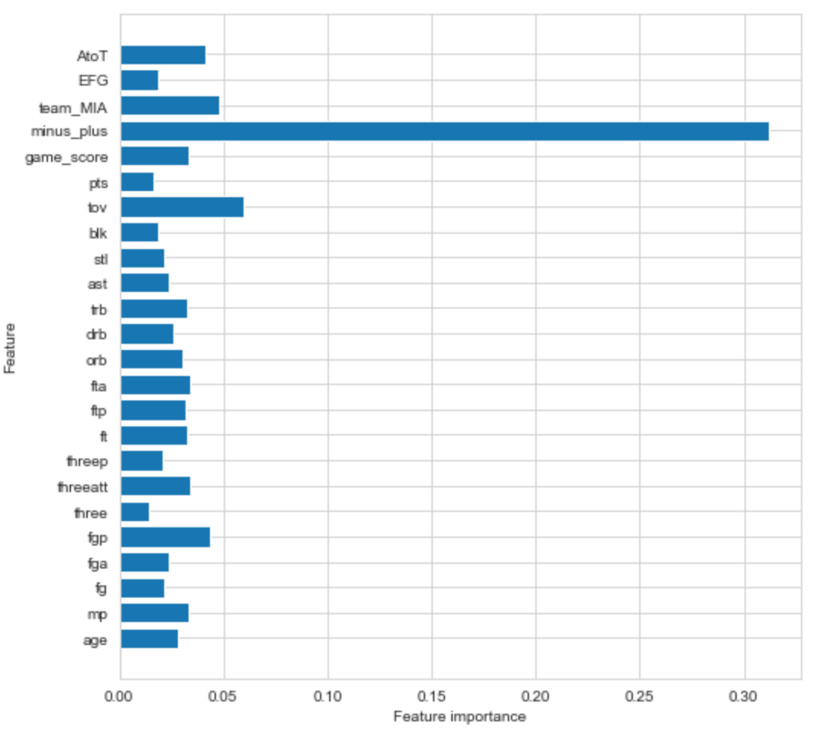
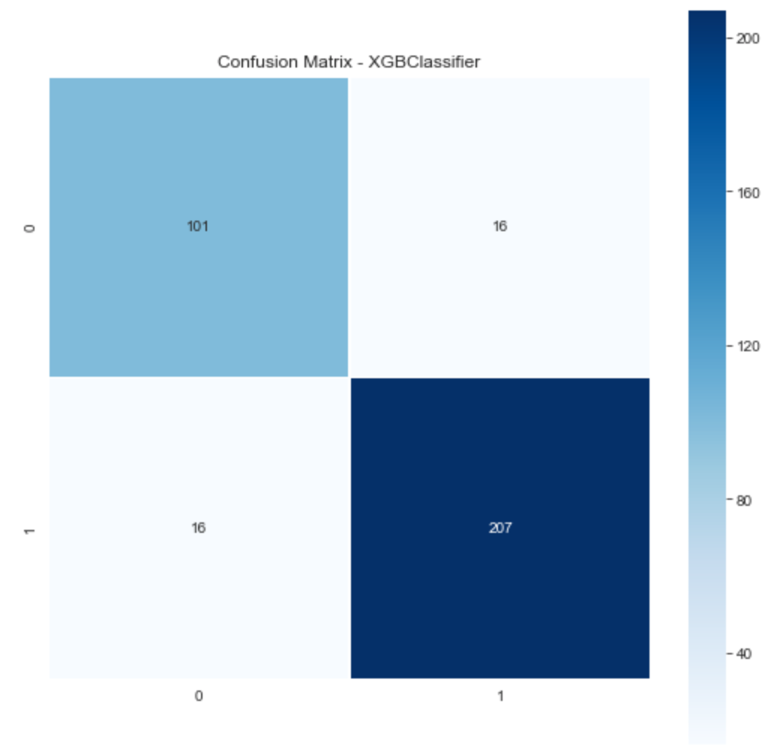
XGBoost Model - Score, Confusion Matrix, Feature Importance
Training Accuracy - 92.42 %
Validation Accuracy- 91.48 %
Notes:
Confusion Matrix - (sky blue)TN 101 /379 (navy blue)TP 207 /379 TN went up by 5
white(bottom) FN 16 /379 (white top)FP 16 /379
False positive went down compared to before and
true negative went up by 10 ^^^ bc TN identified more correctly overall accuracy went up
Accuracy - TP + TN/ TOTAL how many I’m classifying correctly 91.48% accuracy went up by 1%
Model is getting better at classifying Losses more with each model. Identifying true positive has been same overall avg. 208

Slide 12
Scores Table for all Models
Model Type | Training Accuracy | Validation Accuracy
Logistic Regression | 89.40% | 86.93%
Decision Tree | 94.19% | 87.94%
Random Forest | 89.52 % | 90.0 %
XGBoost | 92.42 % | 91.48 %
Notes:
training accuracy is usually the accuracy you get if you apply the model on the training data, while testing accuracy is the accuracy for the testing data.
Want difference between training and validation set to be small. Demonstrates model is not overfitting.
It's sometimes useful to compare these to identify overtraining.

Slide 13
Making predictions
Below average game: Age 28, 12pts, 3 Ast, 4RB, 1 Three, FG 40%, 5T0 …. Model predicted a Loss
Average game: Age 28, 28pts, 10 Ast, 5RB, 3-3PM, FG 50%, 2 TO...Model predicted a Win
Above average game: Age 28, 36pts, 10Ast, 10RB, 4-3PM, FG 60%, 2TO... Model predicted a Win
Notes:
Good way to show how Lebron's performance reflects a team win or loss. Throughout his career his team relies on him heavily. If he has a bad game they lose, if he has an average game or above average they win.

Slide 14
Key takeaways / Conclusions
XGBoost model selected because has highest validation accuracy. Also difference in test and validation accuracy is smallest which indicates less overfitting.
Answer: Lebron’s performance is a major indicator on whether or not his team wins. The fact that the model can predict a team win or loss with only 1 players statistics demonstrates how strong Lebron’s performance is on his teams success.
To further demonstrate Lebrons impact on team success, can run model for an average player with similar career arc and see how well team win or loss is predicted.
Further exploration: Can run these models for other players.
For example, who had more of an impact on their team, Jordan or Lebron ? Is this the best method to answer that question?
Plus-Minus is a good indicator of how valuable a player is to a team’s success. How good would the selected model perform if it were removed?

Slide 15
Improvements
Adjust class imbalance because model classifies wins more.
Run other models liked SVM or add more features to see if accuracy improves

Slide 16
